Slide 1
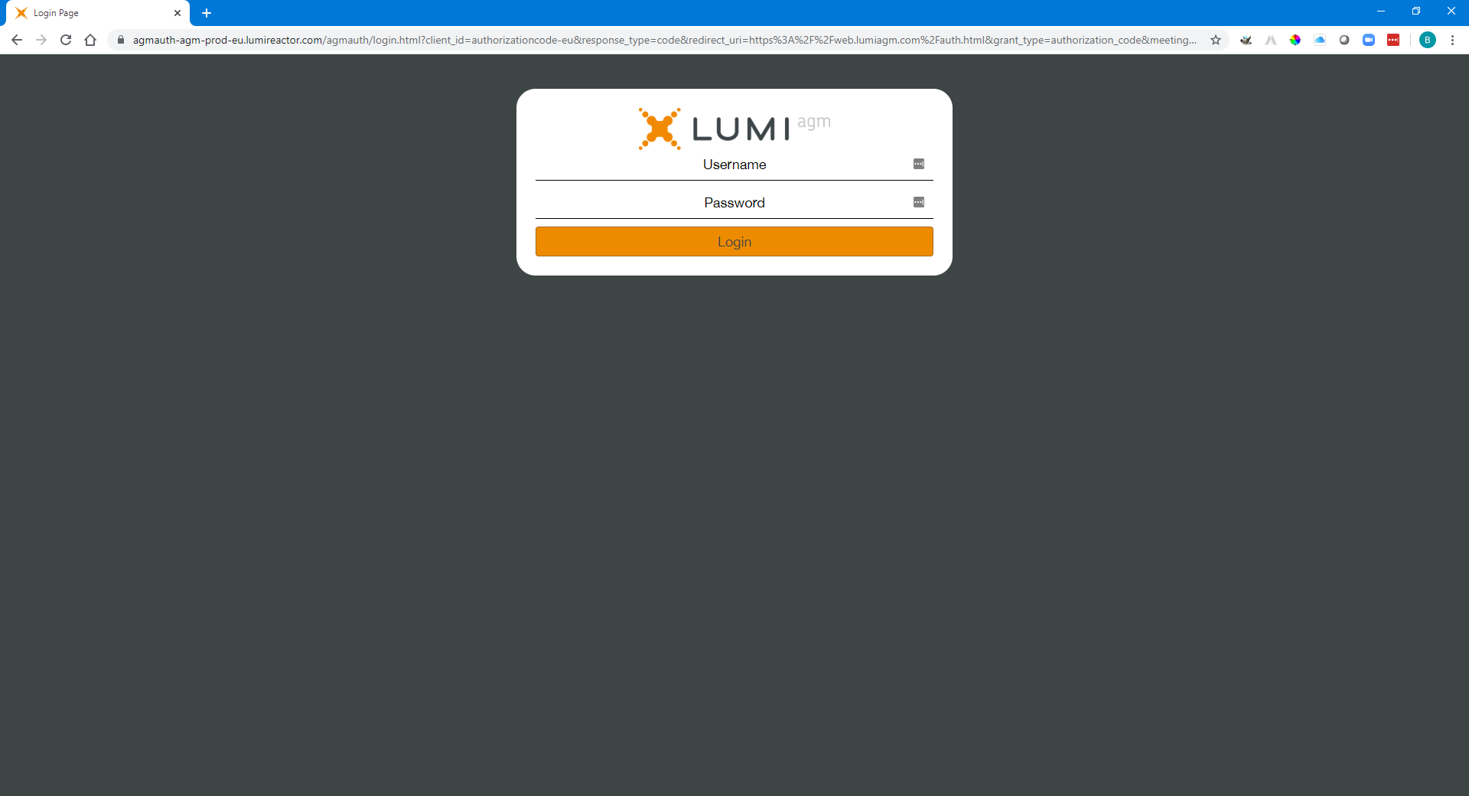
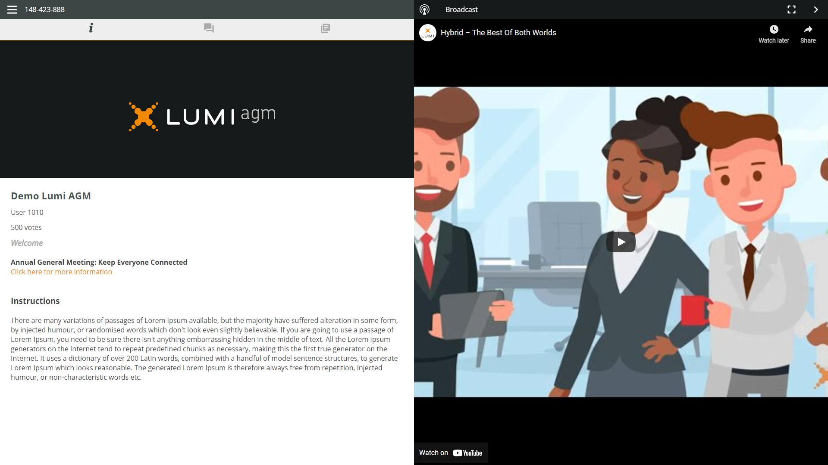
Manual for the virtual meeting
This year we’re having a virtual meeting, allowing you to participate online, using your smartphone, tablet or computer.
You will be able to view a live webcast of the meeting, ask the Directors questions online and submit your votes in real time.
Visit https://web.lumiagm.com/183502649 in your web browser
(no Google search) on your smartphone, tablet or computer.
Please ensure you have the latest versions of Chrome, Safari and Edge.
DON’T USE INTERNET EXPLORER.
Log in in time to ensure that your browser is compatible.
If you have voting rights, select "Login" and enter your username and password.
You will be able to log into the site from 09:30h, 18th May 2021.

Slide 2
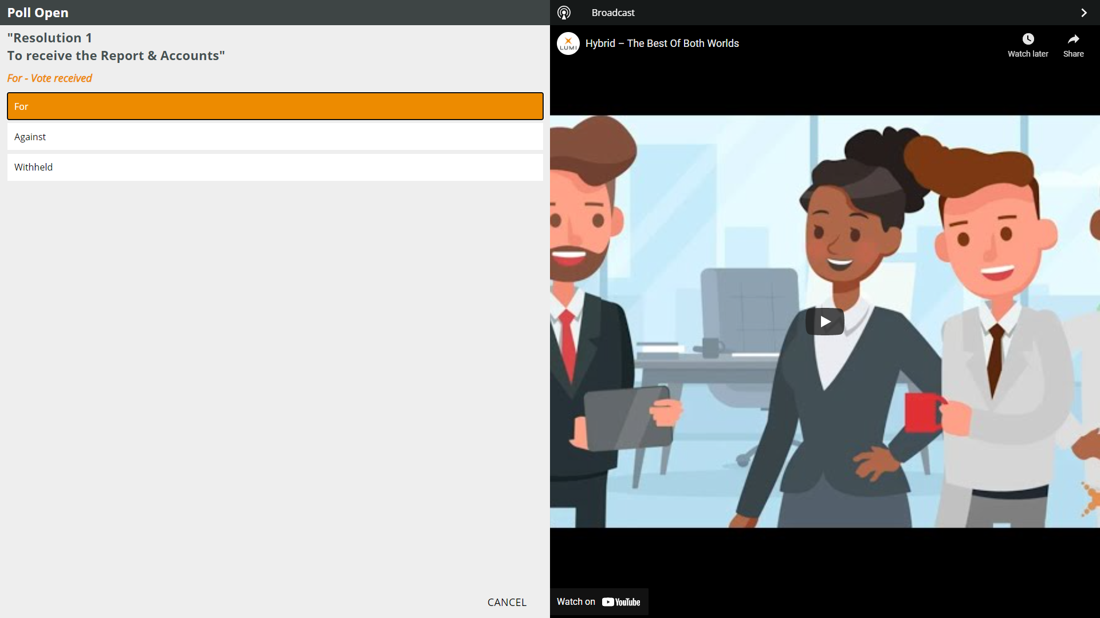
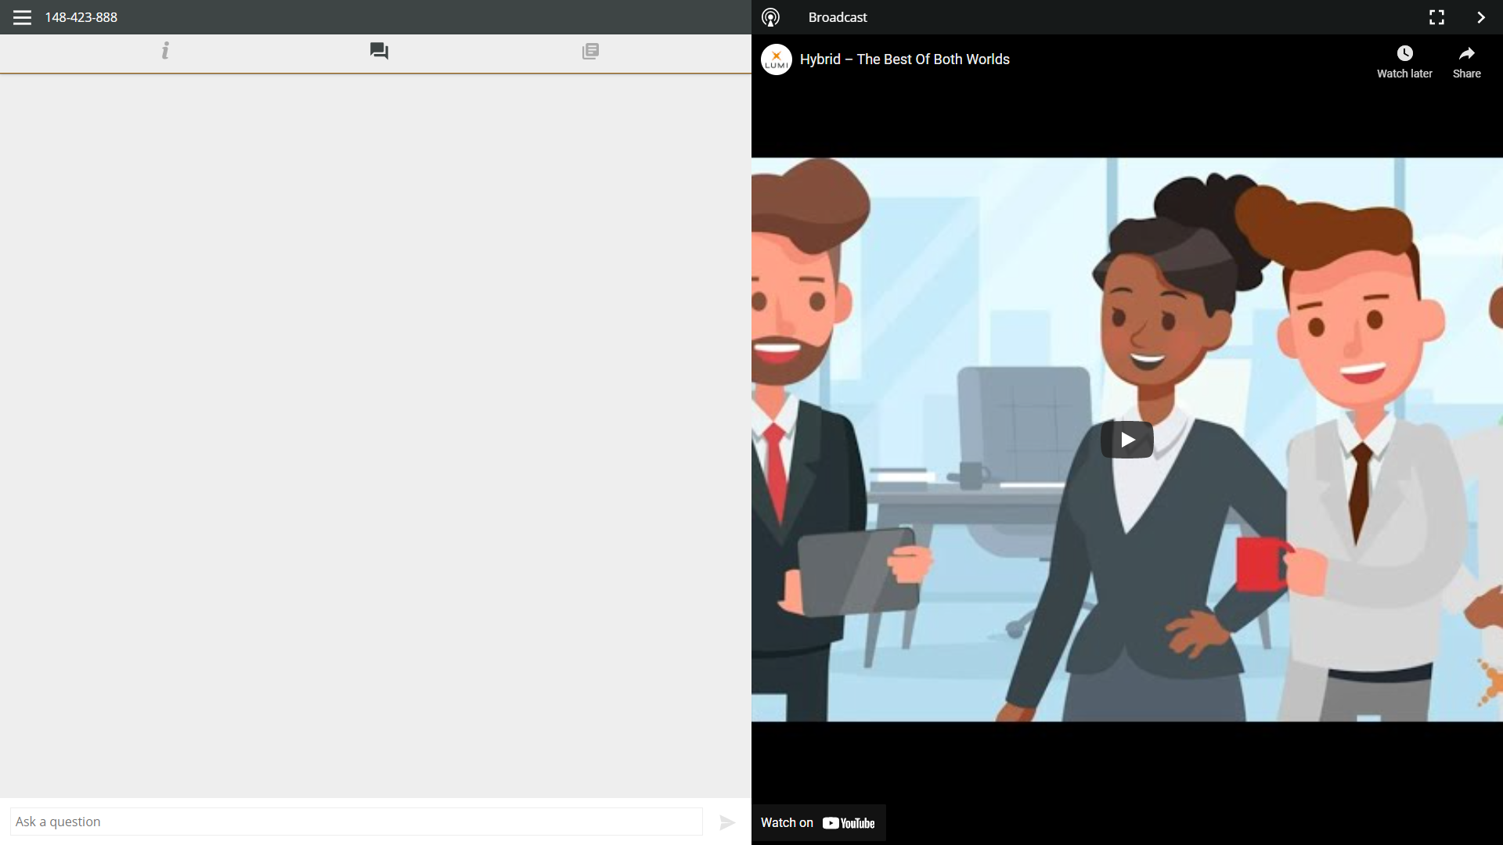
NAVIGATION
VOTING
Voting during the meeting
When successfully authenticated, the info screen will be displayed.
You can view company information, ask questions and vote.
If a vote is to be taken during the meeting, it will automatically appear on the screen.
To vote, select your choice from the options displayed on the screen.
A message will appear that your vote has been received.
To change your vote, press another choice.
If you want to cancel your vote, press Cancel.
QUESTIONS
Any shareholder is eligible to ask questions.
If you would like to ask a question, select the messaging icon
Messages can be submitted at any time during the Q&A session up until the Chairman closes the session.
Type your message in the chat box at the bottom of the message screen.
If you are happy with your message, click
the send button.
Questions sent via the Lumi AGM online platform will be moderated before being sent to the chairman.

